Slide 1
WDC Basics Future Skills Academy 2017 Daniel Chabr Watson iLab developer

Slide 2
Projects Overview
Business Problem – Usecase
Knowledge Management – combining Chatbot with discovery service
Complaint Management – analyzing complaints – using NLU, Discovery Service
eShop Advisor – Use chatbot for receiving customer details
Search for similar things - Visual API – try to find similar Components
Chatbot for querying OSINT – Citizen mood of EU
Visual custom classifier of broken components (controlled by chatbot)
Create Speech to text Advisor to help with abbreviations – for disabled people
Combine Chatbot, Weather, Visual API for various applications
Notes:
Define list of sample projects for teams in the stream (at least 5 ideas), and build any code/instructions needed for these projects
Chatbot for querying news
In this project we create conversation application which will help user to query datasource. We will use dataset of preenriched news articles - Discovery News. Application will have predefined dialog flow which will help user to answer several questions about dataset. Dataset could be different one if the team brings another source of data.
Chatbot delegate based on sentiment
This project should be about adapting the conversation to the user's emotion. If the sentiment of the user's response goes below given threshold, reroute to live customer support agent should be done. This project should make use of Watson Conversation and Natural Language Understanding services. The reroute should be done to an external service, e.g. Telegram or Slack. The full scenario should follow real user story of escalating a complaint from chatbot to live customer service.
Visual custom classifier of broken components (controlled by chatbot)
In this project personal assistant that will help user identify object will be made. End application will be mobile Telegram bot which will receive pictures taken from camera and will help determine user which object is in front of him.
Train customer speech to text model to build IT abbreviations chatbot
This project would help novices in an organization to understand commonly used abbreviations. In real world scenario it would be extended to cover other topics. Speech to text has a general model, but for this scenario a custom model should be trained so that spoken abbreviations can be correctly recognized and explained. For the abbreviation description a custom tag should be used in Conversation service and replaced with relevant text from a lookup table in the orchestration application. This way hard coding of all possible abbreviation explanations in the Conversation service can be avoided.
Create custom tag in Conversation that displays weather forecast in given location
In this project a user may ask about a certain location a together with the answer from the Conversation service we want to display weather infographics. Custom tag in Conversation service should be used in Conversation service to dynamically query Weather API for up to date weather forecast and then generate HTML template for displaying weather data to the user in a natural way.
feel free to bring your own project

Slide 3
Agenda
setup Conversation instance
create intents, entities
create dialog tree utilizing both intents and entities
train classifier
setup UI and orchestration app
create Slack bot
setup orchestration app and install Slack node
create request and response routing to Conversation service

Slide 4
What is Conversation service?
Combines:
machine learning
natural language understanding
integrated dialog tools
to create conversation flows between your apps and your users.
Basic terms
Intent
Entity
Dialog
Context

Slide 5
What is Conversation service?

Slide 6
Intents and entities
purpose or goal expressed in an input
recognizing input => choose the correct dialog flow
represents a class of object or a data type

Slide 7
Dialog
uses the intents and entities
interacts with the user and provides a response

Slide 8
Development
Two options how to use Conversation API:
Curl based API
Download and install programming language API
Node SDK - https://github.com/watson-developer-cloud/node-sdk
Java SDK - https://github.com/watson-developer-cloud/java-sdk
Python SDK - https://github.com/watson-developer-cloud/python-sdk
iOS SDK - https://github.com/watson-developer-cloud/swift-sdk
Unity SDK - https://github.com/watson-developer-cloud/unity-sdk

Slide 9
Node-RED
flow-based programming for the Internet of Things
browser-based editor

Slide 10
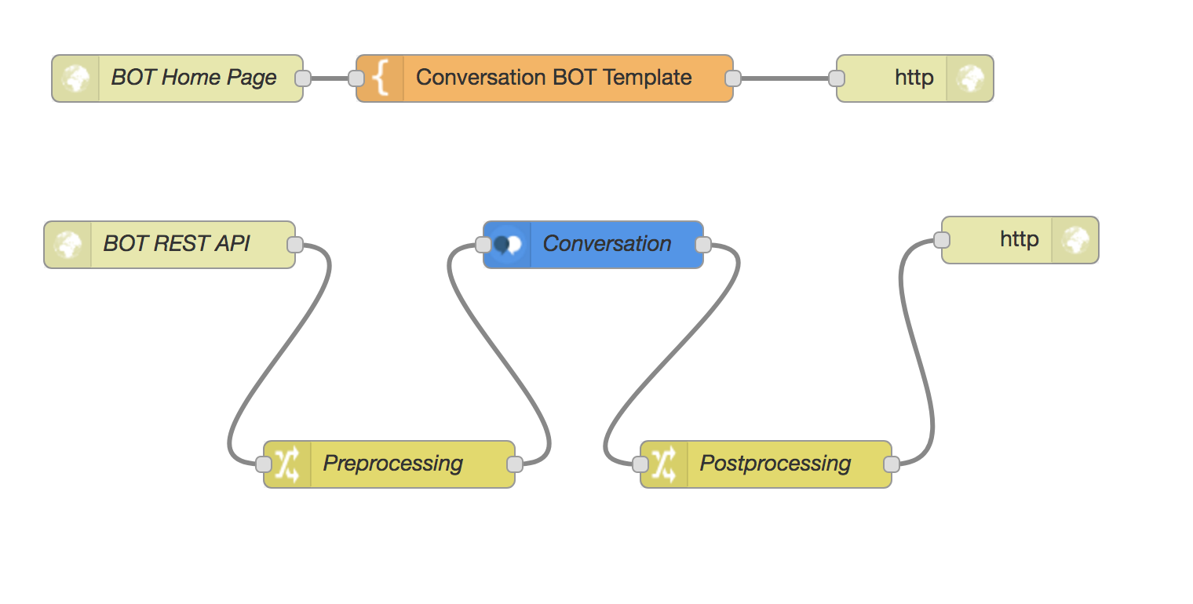
Node-RED
Basic terms
Node
Component
Flow

Slide 11
WDC in Node-RED
example labs on GitHub: https://github.com/watson-developer-cloud/node-red-labs
all APIs as nodes with easy configuration
+ Bluemix = easy credentials management

Slide 12

Slack bot integration

Slide 13
Resources
Documentation: https://www.ibm.com/watson/developercloud/doc/conversation/index.html
API reference: https://www.ibm.com/watson/developercloud/conversation/api/v1/
GitHub with workshop notes: https://github.ibm.com/fsa2017/cognitive-stream

